Slide 1
Simulation of Sensorless Digital Control of BLDC Motor Based on Zero Cross Detection.
Author-Tae-Hyung Kim:Byung-Kuk Lee; M. Ehsani
DOI: 10.1109/APEC.2003.1179231

Slide 2
OBJECTIVE:
This Paper Presents Proposed New sensorless Drives Methods which eliminates the problem of Lack of low speed Operation So it ensures high accurate robust sensorless operation from zero to high speed

Slide 3
ABSTRACT
This permanent magnet BLDC motor is increasingly being used in computer, aerospace, military, automotive, industrial and household products because of its high torque, compactness, and high efficiency
For this purpose a speed independent function based on new flux linkage function is used.
This motor is electronically controlled and requires rotor position information for proper commutation of currents.
Practical minimum speed of the conventional sensorless drive is around 10% of the rated speed
Position error from a phase shifter in transient state deteriorates the performance of sensorless drive.

Slide 4
This paper presents a novel sensorless position detection technique with a new physical concept based on a speedindependent position function for the BLDC motors.
Speed-independent position function that is a function of measured currents and calculated voltages,the commutation instants can be estimated from near zero (1% of the rated speed) to high speed.

Slide 5
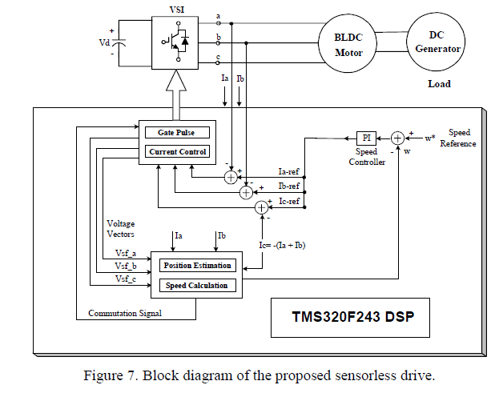
CIRCUIT DIAGRAM:

Slide 6
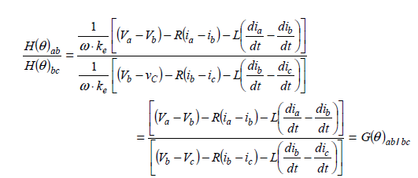
Derivation of the Speed-independent Position Function
To eliminate the speed term ω, one line-to line H( )function is divided by another line-to line H()function
To provide the best position information that is speed independent with high sensitivity at each commutation point, we utilize the ratio of two line-to-line H(θ )functions. From the sequential combination of two line-to-line H(θ )functions at each commutation interval, we derive the G(θ) function that is independent of speed and contains continuous position information.

Slide 7
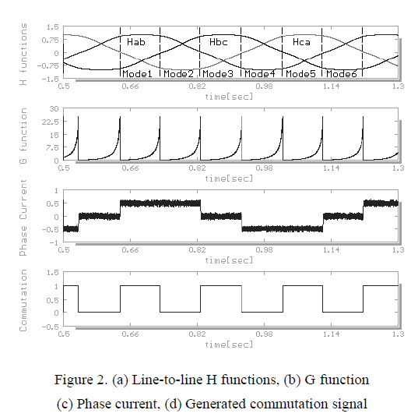
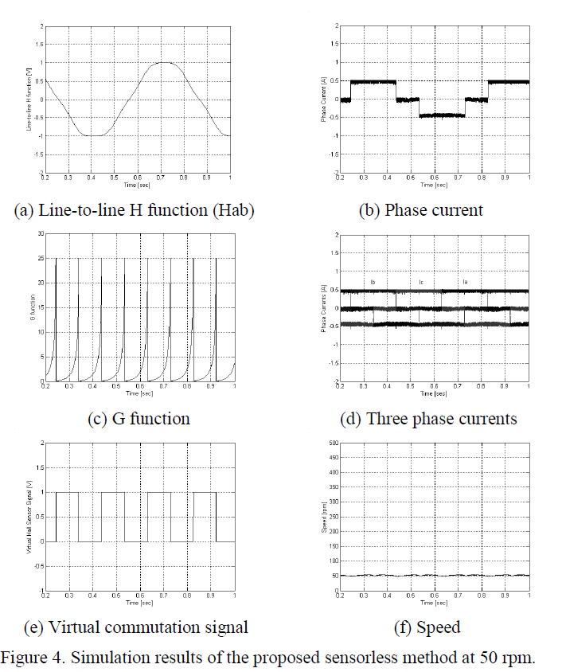
SIMULATIONS AND RESULTS:

Slide 8
CONCLUSIONS:
This paper presented a novel sensorless drive method for BLDC motors.
This technique makes it possible to detect the rotor position over a wide speed range from near zero to high speed. The capability of position detection at around 1% of the rated speed makes the starting procedure much simpler than conventional methods. Also, the proposed approach provides a precise commutation pulse even at transient state because of the speed independent characteristic of the G(θ ) function.

